Slide 1

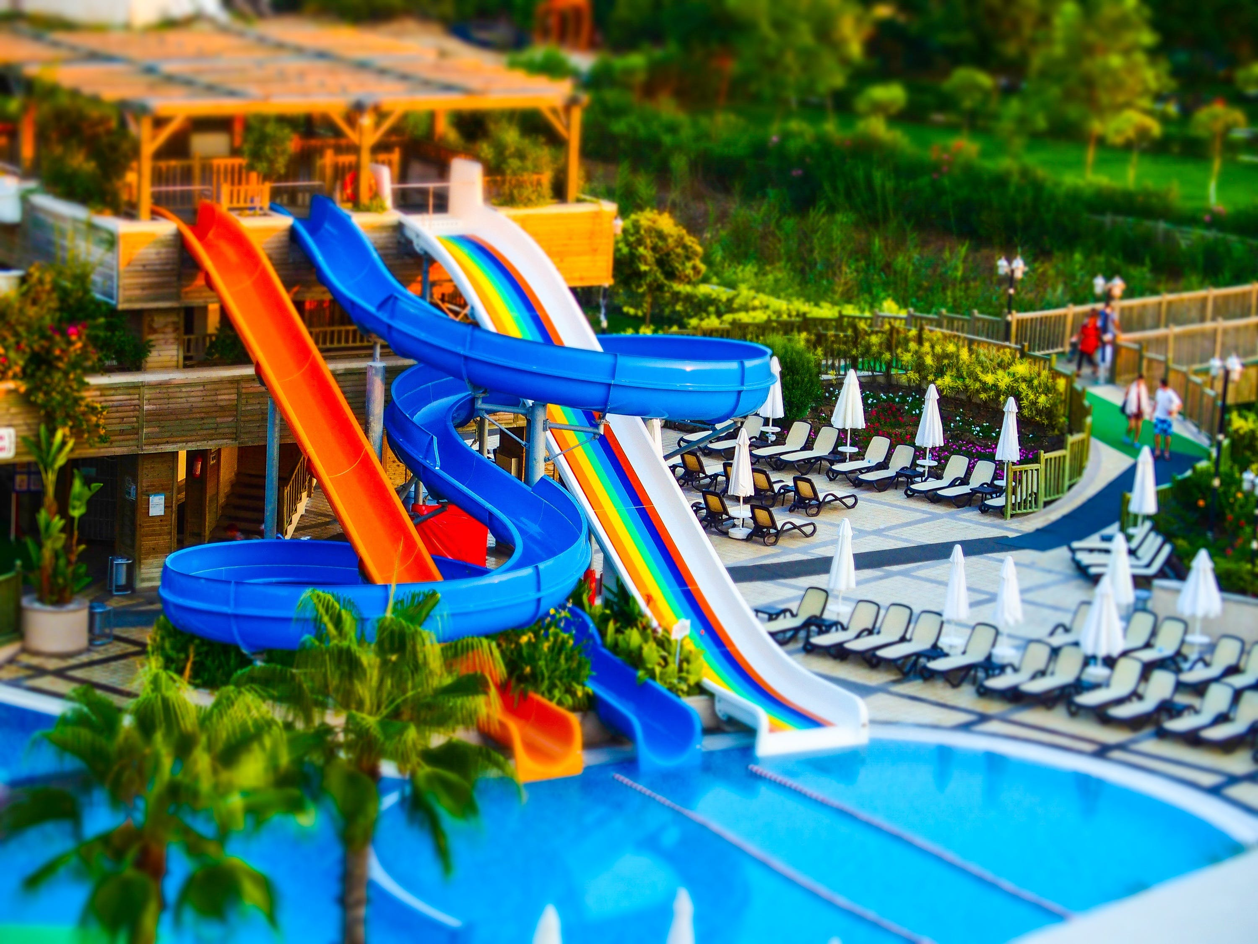

Home
Cafe
Contact
Shop
Park
About
HOME PAGE
Explore the wonders of Colletta Atlanta, nature's unparalleled gift, where visitors can immerse themselves in a world of beauty. This premier attraction showcases a vibrant marketplace featuring top-selling local produce and plants, alongside a charming petting zoo, a welcoming cafe, a playful park, and serene walking paths. Colletta also presents a unique dining experience with its "For the Table" option, designed to enhance the joy of family-style dining. Available every morning to evening in addition to the extensive menu, it celebrates the essence of shared meals and diverse cuisines.
Sitemap
Home
Colletta Atlanta
Shop
Cafe
22 Foothead Sheet
Glasgow
G21 0RE
Park
Contact
© 2024 - Colletta Atlanta
About

Slide 2













Cafe
Contact
Home
Park
About
SHOP PAGE
Presenting our Shopping Selections :
Sitemap
Home
Colletta Atlanta
Shop
Colletta Atlanta
Cafe
22 Foothead Sheet
Glasgow
G21 0RE
22 Foothead Sheet
Glasgow
G21 0RE
Park
Contact
© 2024 - Colletta Atlanta
About

Slide 3




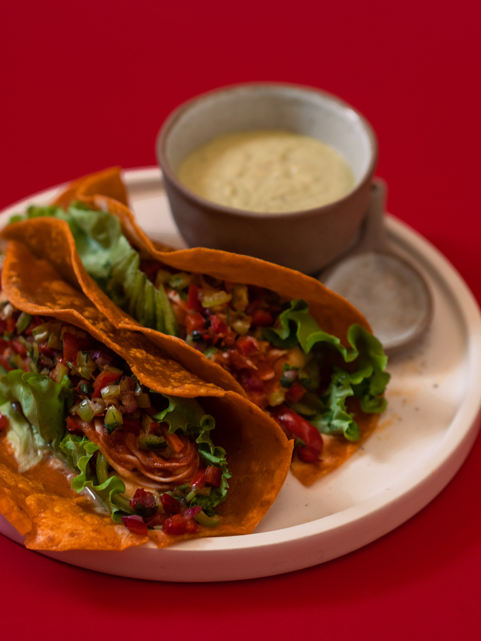




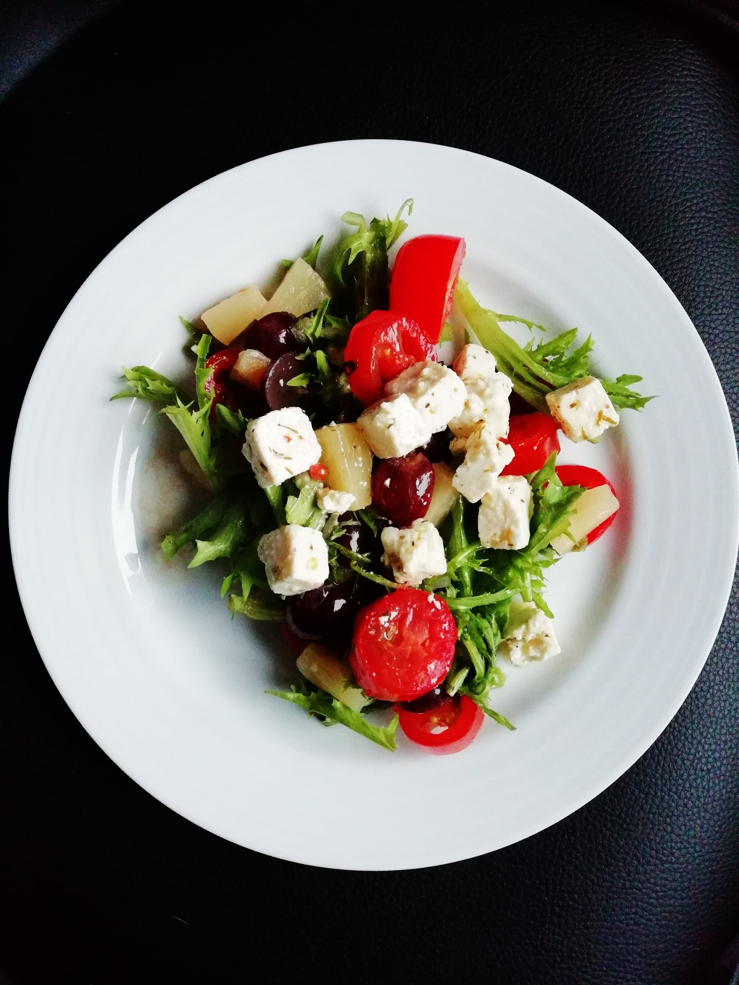

Contact
Home
Park
About
Shop
CAFE PAGE
Presenting Our Menu Selections:
Sitemap
Home
Colletta Atlanta
Shop
Colletta Atlanta
Cafe
22 Foothead Sheet
Glasgow
G21 0RE
22 Foothead Sheet
Glasgow
G21 0RE
Park
Contact
© 2024 - Colletta Atlanta
About

Slide 4
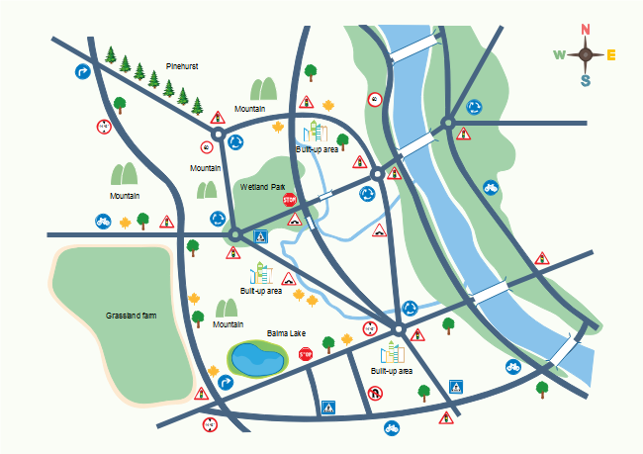


Home
About
Shop
Contact
Cafe
PARK PAGE
The Colletta Atlanta Park Resort Center offers a variety of activities for all ages, including hiking, biking, canoeing, paddleboarding, fishing, rock climbing, and zip-lining. There's also an eco-friendly playground and a water park for families and children to enjoy.
An adventure-filled world awaits.
Swing Session
The image captures a contemplative child seated on a swing at a playground, facing away from the camera. The swing is attached to a structure with vividly painted chains and bars, predominantly red, contrasting with the blurred greenery of the background. The child's relaxed pose and the wild curls of hair suggest movement and a gentle breeze.
More of it scroll down
Sitemap
Home
Colletta Atlanta
Shop
Colletta Atlanta
Cafe
22 Foothead Sheet
Glasgow
G21 0RE
22 Foothead Sheet
Glasgow
G21 0RE
Park
Contact
© 2024 - Colletta Atlanta
About

Slide 5
Cafe
Contact
Home
Park
About
SHOP PAGE
Presenting our Shopping Selections :
Sitemap
Home
Colletta Atlanta
Shop
Colletta Atlanta
Cafe
22 Foothead Sheet
Glasgow
G21 0RE
22 Foothead Sheet
Glasgow
G21 0RE
Park
Contact
© 2024 - Colletta Atlanta
About

Slide 6




Home
Cafe
About
Shop
Park
CONTACT PAGE
Contact us
Please feel free to get in touch using the contact information provided below.
Send us a message
Full Name
Your Email id
Nigeria
Yours Remarks….
Submit
Sitemap
Home
Colletta Atlanta
Shop
Colletta Atlanta
Cafe
22 Foothead Sheet
Glasgow
G21 0RE
22 Foothead Sheet
Glasgow
G21 0RE
Park
Contact
© 2024 - Colletta Atlanta
About

Slide 7

Cafe
Contact
Home
Park
About
ABOUT US PAGE
About Colletta Atlanta
Colletta Atlanta is a premier destination located in the vibrant heart of the city, offering a rich blend of leisure, shopping, and culinary experiences. It features Colletta Park, a tranquil green space with winding trails, beautiful gardens, and peaceful water features, perfect for both relaxation and outdoor adventures.
The shopping center within Colletta Atlanta boasts a wide range of shops from high-end boutiques to local artisans, catering to shoppers in search of both international brands and unique items.
The on-site café overlooks the park, serving gourmet dishes, pastries, and drinks in a serene setting ideal for dining and socializing. Together, these facilities make Colletta Atlanta a diverse hub for visitors seeking enjoyment and relaxation in an urban oasis.
Mission and Vision
At Colletta Atlanta, we are driven by a passion to enrich the lives of our visitors through exceptional experiences. Our mission is to create a community hub where the beauty of nature, the excitement of shopping, and the joy of dining converge in harmony.
We are committed to excellence, sustainability, and innovation, ensuring that Colletta Atlanta remains a cherished destination for all who seek to make their day a little more special.
Meet Our Team
Ozumba Ambrose
Paul Doe
Rosie Meg
Alex Wood
CEO / MANAGINING DIRECTOR
EVENT MANAGER
FRONT-OFFICE MANAGER
SUPPORT LEAD
Sitemap
Home
Colletta Atlanta
Shop
Colletta Atlanta
Cafe
22 Foothead Sheet
Glasgow
G21 0RE
22 Foothead Sheet
Glasgow
G21 0RE
Park
Contact
© 2024 - Colletta Atlanta
About

Slide 8
Home
Shop
Park
Contact
About
Cafe
Hierarchy of a Website

Slide 9
WIREFRAME
Colletta Atlanta
Home
Shop
Cafe
Park
Contact
About
Colletta Atlanta
HOME PAGE
Write your text
Explore
IMAGE BACKGROUND FLIPPING
(30 SECONDS)
IMAGE BACKGROUND FLIPPING (30 SECONDS)
Text
text
Time and
Days
text
Sitemap
Home
Shop
Cafe
Park
Contact
About
Colletta Atlanta
22 Foothead Sheet
Glasgow
G21 0RE
© 2024 - Colletta Atlanta

Slide 10

WIREFRAME
Colletta Atlanta
Home
Cafe
Park
Contact
About
Shopping Session in Colletta Atlanta
SHOP PAGE
Presenting our Shopping Selections:
Description
Amount
Add Cart
CARD FLIPPING
Description
Amount
BACK FLIP
Add Cart
Sitemap
Home
Shop
Cafe
Park
Contact
About
Colletta Atlanta
22 Foothead Sheet
Glasgow
G21 0RE
© 2003 - Colletta Atlanta

Slide 11
WIREFRAME
Colletta Atlanta
Home
Shop
Park
Contact
About
Colletta Atlanta Gallery
CAFE PAGE
Presenting our Menu Selections:
Description
Amount
Add Cart
CARD FLIPPING
Description
Amount
BACK FLIP
Add Cart
Sitemap
Home
Shop
Cafe
Park
Contact
About
Colletta Atlanta
22 Foothead Sheet
Glasgow
G21 0RE
© 2003 - Colletta Atlanta

Slide 12
WIREFRAME
Colletta Atlanta
Home
Shop
Cafe
Contact
About
PARK PAGE
Tour The Play Park
Text here xxxxxxxxxxxxxxxxxxxxxxxxxxxxxxxxxxxxxxxxxxxxxxxxxxxxxxxxxxxxxxxxxxxxxxxxxxxxxxxxxxxxxxxxxxxxxxxxxxxxxxxxxxxxxxxxxxxxxxxxxxxxxxxxxxxxxxxxxxxxxxxxxxx
Collette Atlanta Map
Text xxxxxxxxxxx
Swing Session
Text here xxxxxxxxxxxxxxxxxxxxxxxxxxxxxxxxxxxxxxxxxxxxxxxxxxxxxxxxxxxxxxxxxxxxxxxxxxxxxxxxxxxxxxxxxxxxxxxxxxxxxxxxxxxxxxxxxxxxxxxxxxxxxxxxxxxxxxxxxxxxxxxxxxx
More of it scroll down
Sitemap
Home
Shop
Cafe
Park
Contact
About
Colletta Atlanta
22 Foothead Sheet
Glasgow
G21 0RE
© 2024 - Colletta Atlanta

Slide 13



WIREFRAME
Colletta Atlanta
Home
Shop
Cafe
Park
About
Contact us
MOVING CONTENT
(30 SECONDS)
CONTACT PAGE
Send us a message
Pleasexxxxxxxxxxxxxxxxxxxxxxxxxxxxxxxxxxxxxxxx infoxxxxxxxxxxxxxxxxxxxxxxx
xxxxxxx
xxxxxxx
Mail: xxxxxxxxxxxxxxxxxxxxxxx
xxxxxxx
Phone: xxxxxxxxxxxxxxxxxxxxxxx
xxxxxxx……..
Location: xxxxxxxxxxxxxxxxxxxxxxx
CLICKABLE EACH OF THE THEM
Submit
Sitemap
Home
Shop
Cafe
Park
Contact
About
Colletta Atlanta
22 Foothead Sheet
Glasgow
G21 0RE
© 2003 - Colletta Atlanta

Slide 14
WIREFRAME
Colletta Atlanta
Home
Shop
Cafe
Park
About
ABOUT PAGE
About Colletta Atlanta
CollettAtlanta xxxxxxxxxxxxxxxxxxxxxxxxxxxxxxxxxxxxxxxxxxxxxxxxxxxxxxxxxxxxxxxxxxxxxxxxxxxxxxxxxxxxxxxxxxxxxxxxxxxxxxxxxxxxxxxxxxxxxxxxxxxxxxxxxxxxxxxxxxxxxxxxxx.
Theshopping xxxxxxxxxxxxxxxxxxxxxxxxxxxxxxxxxxxxxxxxxxxxxxxxxxxxxxxxxxxxxxxxxxxxxxxxxxxxxxxxxxxxxxxxxxxxxxxxxxxxxxxxxxxxxxxxxxxxxxxxxxxxxxxxxxxxxxxxxxxxxxxxxx
xxxxxxxxxxxxxxxxxxxxxxxxxxxxxxxxxxxxxxxxxxxxxxxxxxxxxxxxxxxxxxxxxxxxxxxxxxxxxxxxxxxxxxxxxxxxxxxxxxxxxxxxxxxxxxxxxxxxxxxxxxxxxxxxxxxxxxxxxxxxxxxxxx.
MXXXXXXXXX
MOVING CONTENT
(30 SECONDS)
Meet xxxxxxxxxxxxxxxxx
xxxxxxxxxx
xxxxxxxxxx
xxxxxxxxxx
xxxxxxxxxx
xxxxx
xxxxx
xxxxx
xxxxx
Sitemap
Home
Shop
Cafe
Park
Contact
About
Colletta Atlanta
22 Foothead Sheet
Glasgow
G21 0RE
© 2024 - Colletta Atlanta

